Slide 1
基础算法(五) -- 分治法
23. Merge k Sorted Lists
215. Kth Largest Element in an Array
169. Majority Element
calculate the power of a number
count of inversion pairs
closed pair distance among points
你们的好朋友Eddie

Slide 2
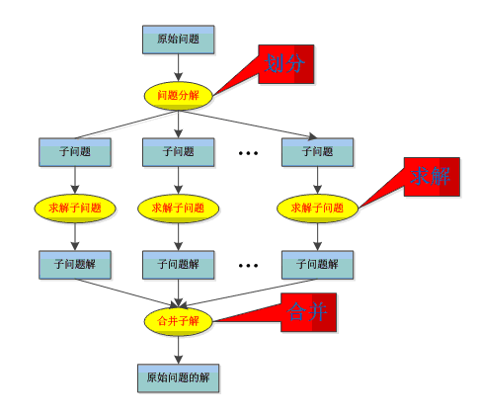
Divide and conquer concept
1、Divide the problem into a number of subproblems that are smaller instances of the same problem.
2、Conquer the subproblems by solving them recursively. If the subproblem sizes are small enough, however, just solve the subproblems in a straightforward manner.
3、Combine the solutions to the subproblems into the solution for the original problem.

Slide 3
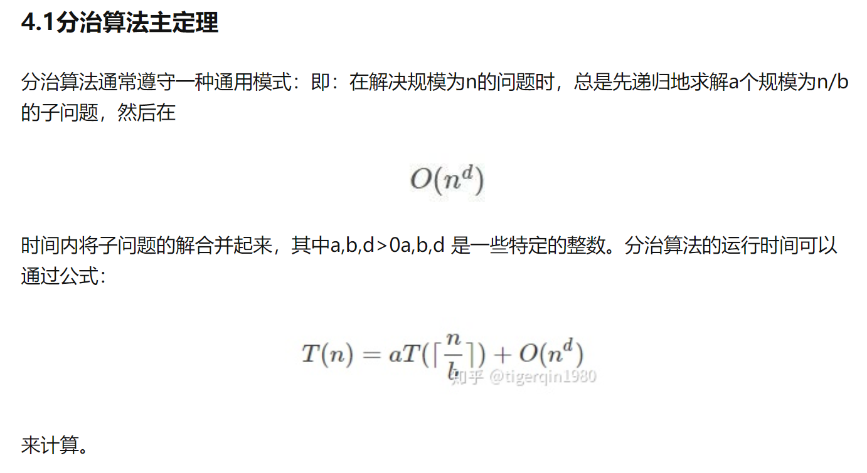
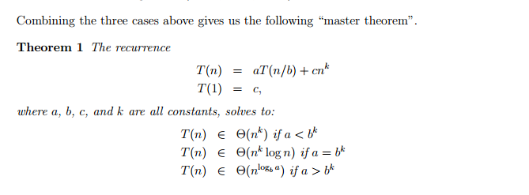
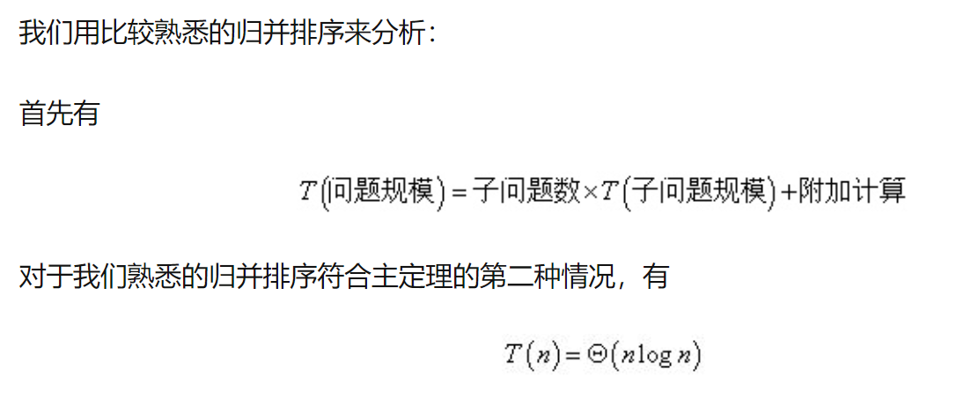
Master Theory

Slide 4
merge sort

Slide 5
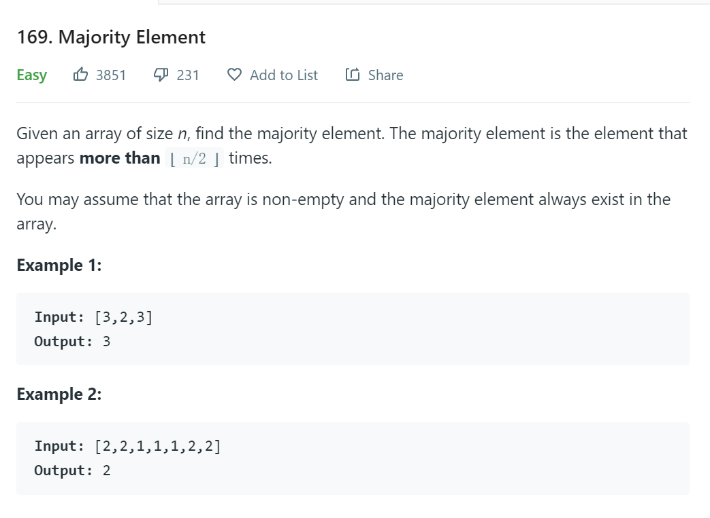
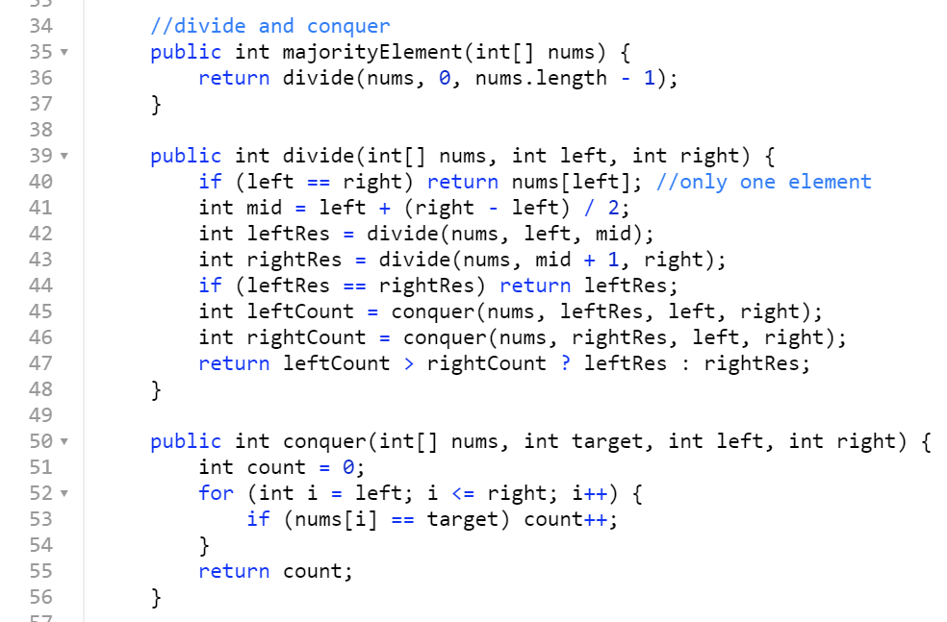
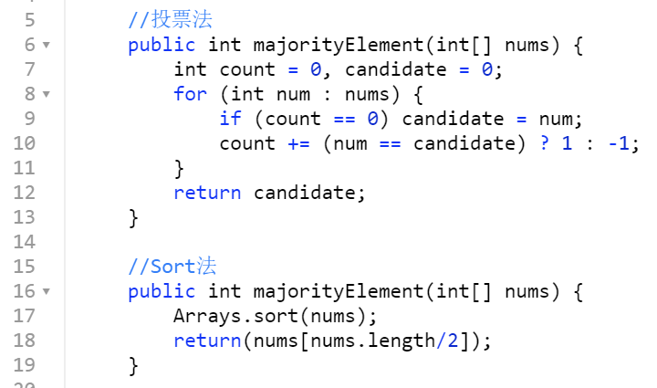
简单的O(nlgn)解法，熟悉分治的思想
最优解为投票法 O(n)无空间O(1), hashmap需要占用空间
一般O(1)空间问题可以用precompute table来计算，如果数数据流324535346456中有几个0，1.可以O(1)空间来做

Slide 6
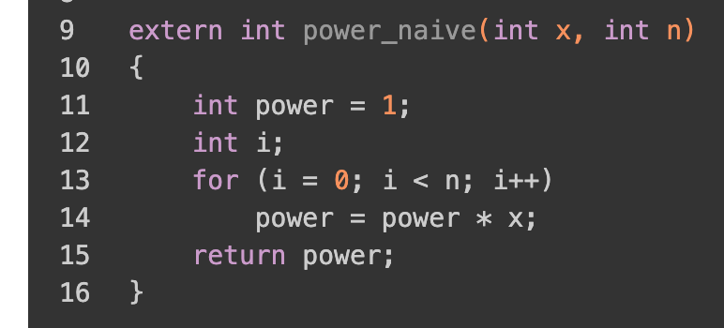
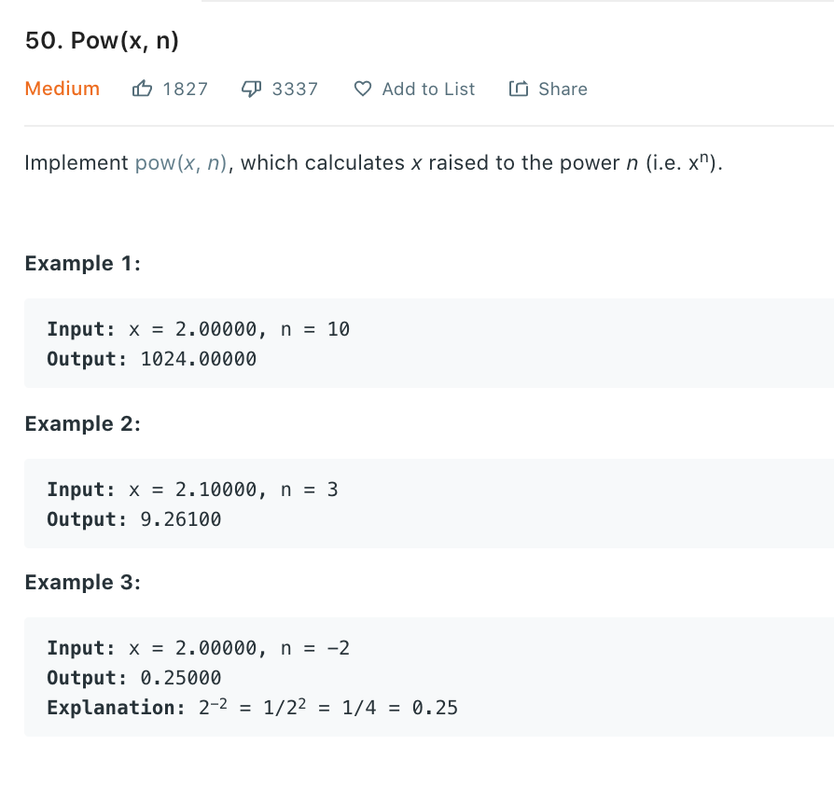
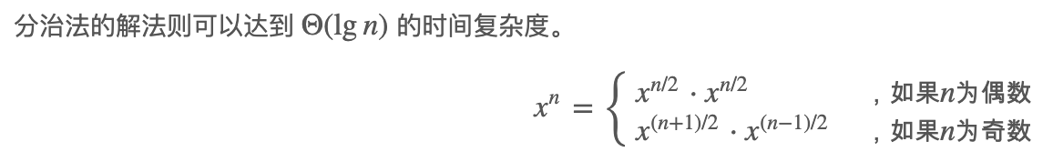
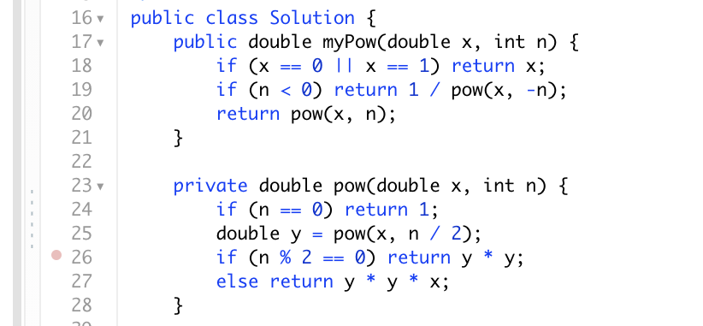
快速幂

Slide 7
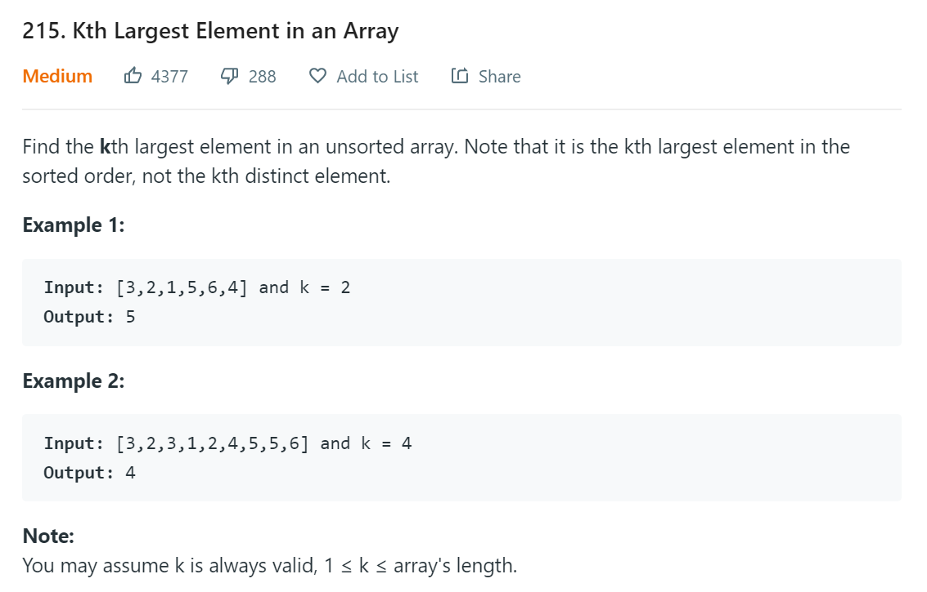
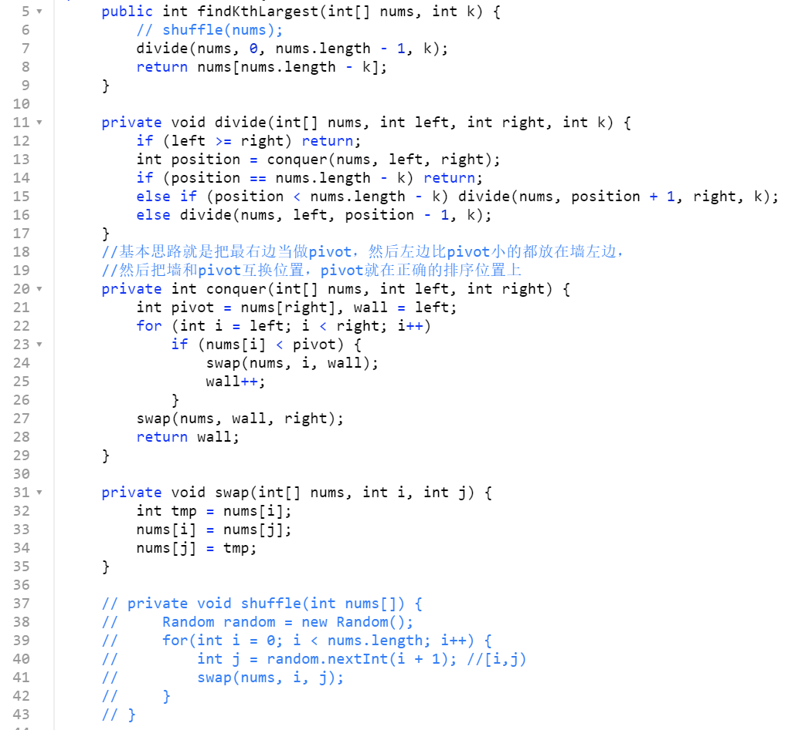
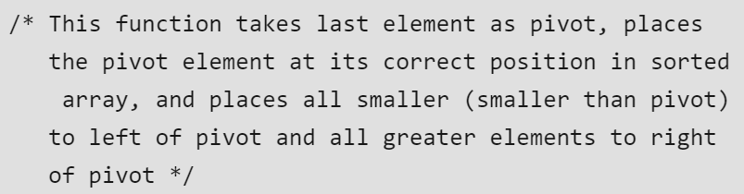
quick sort 的变种, 理解pivot的意义
O(N) the average case, O(N^2)in the worst case.

Slide 8
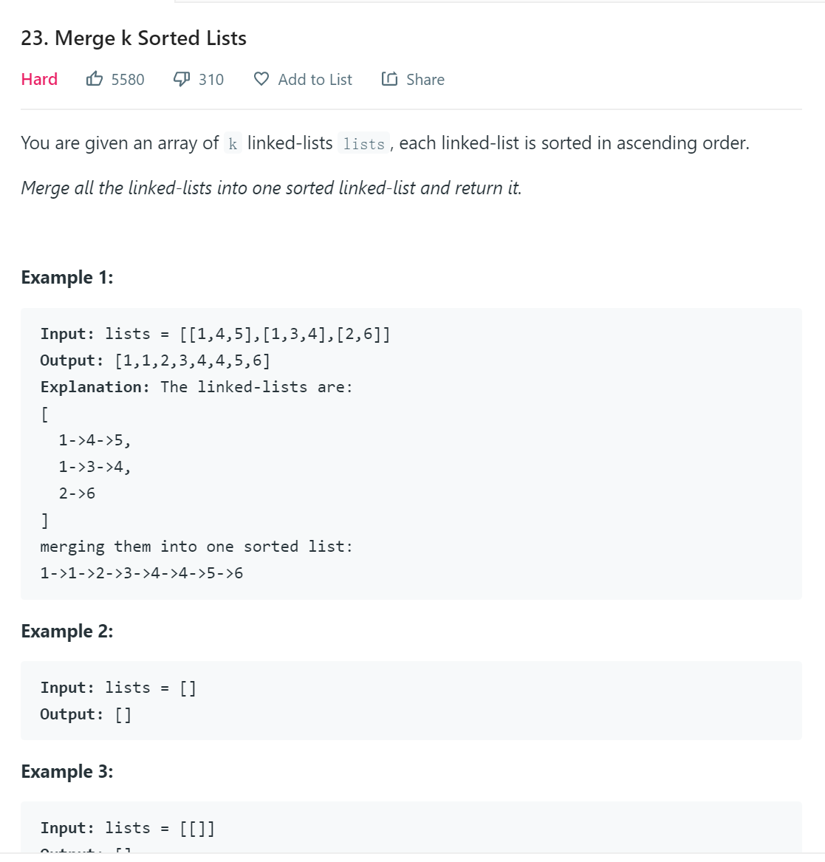
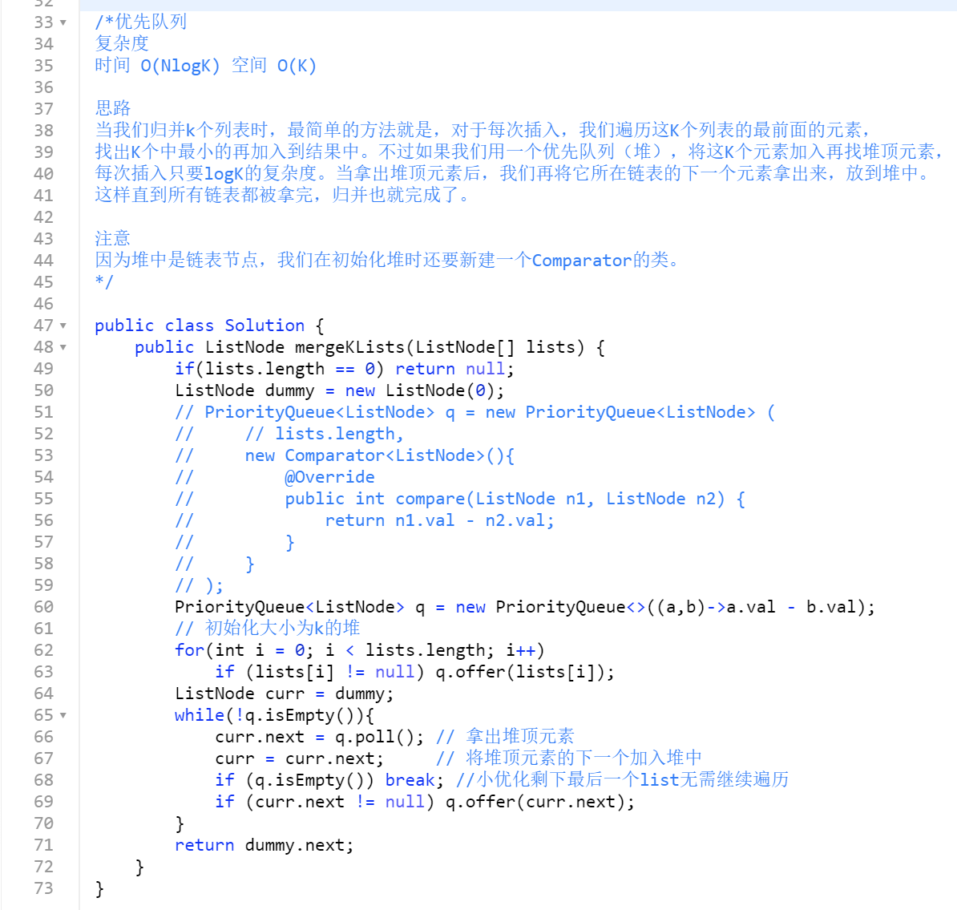
可以使用pq解法，时间复杂度一样
O(nlogk)

Slide 9
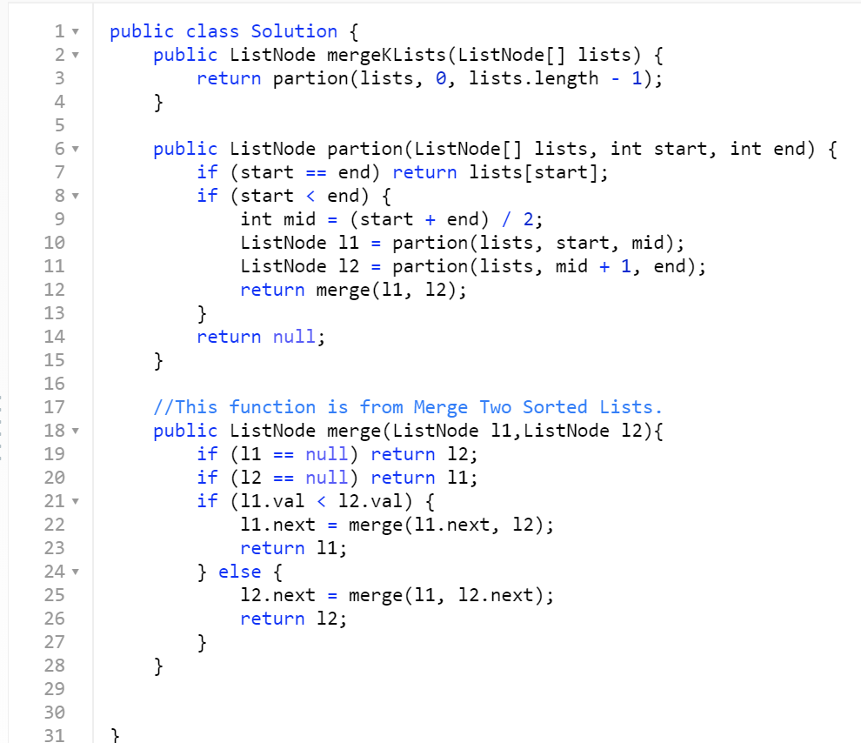
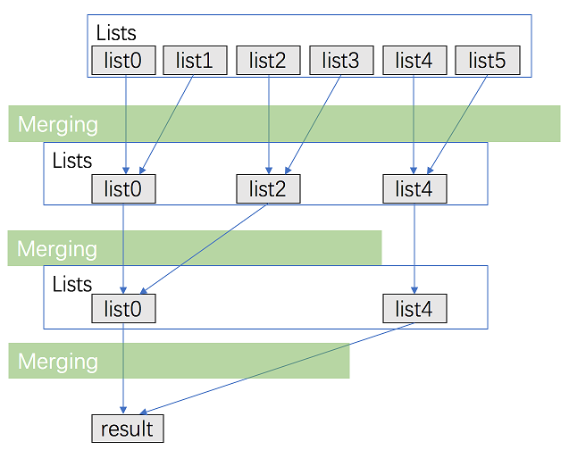
分治法，类似merge sort，先拆开再合并

Slide 10
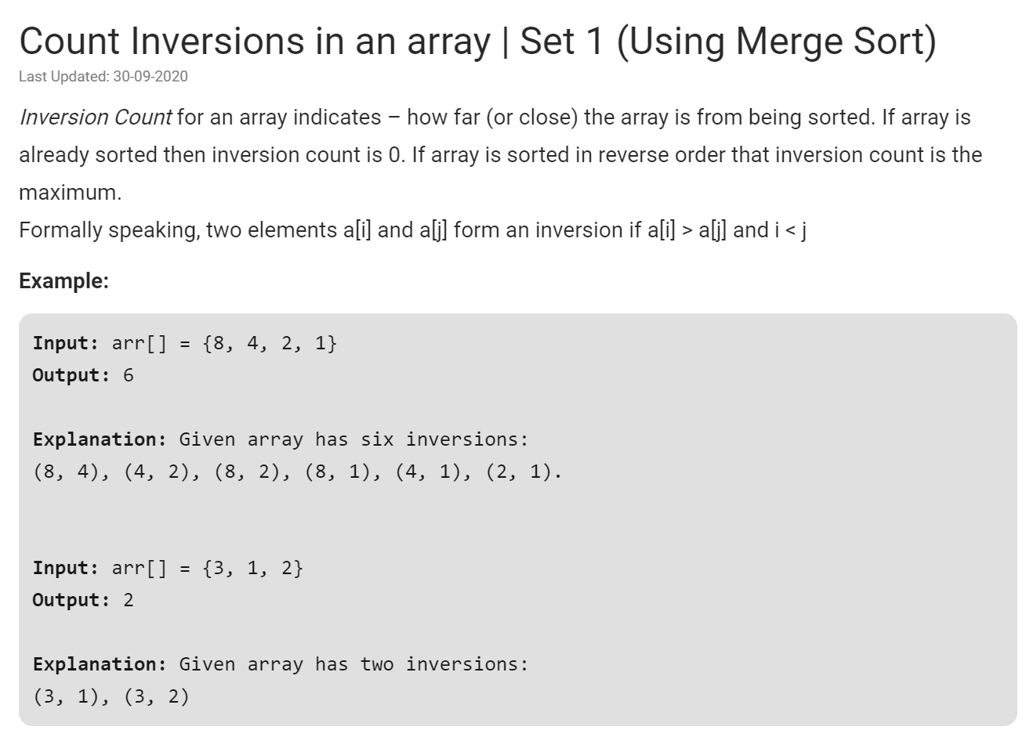

Slide 11
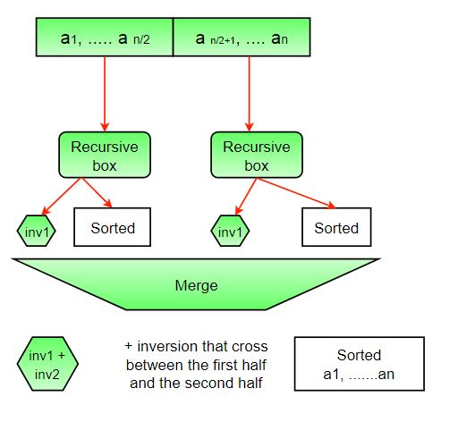
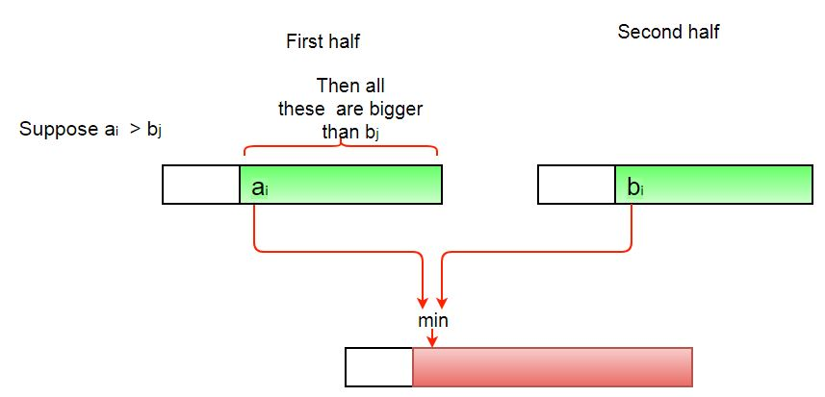
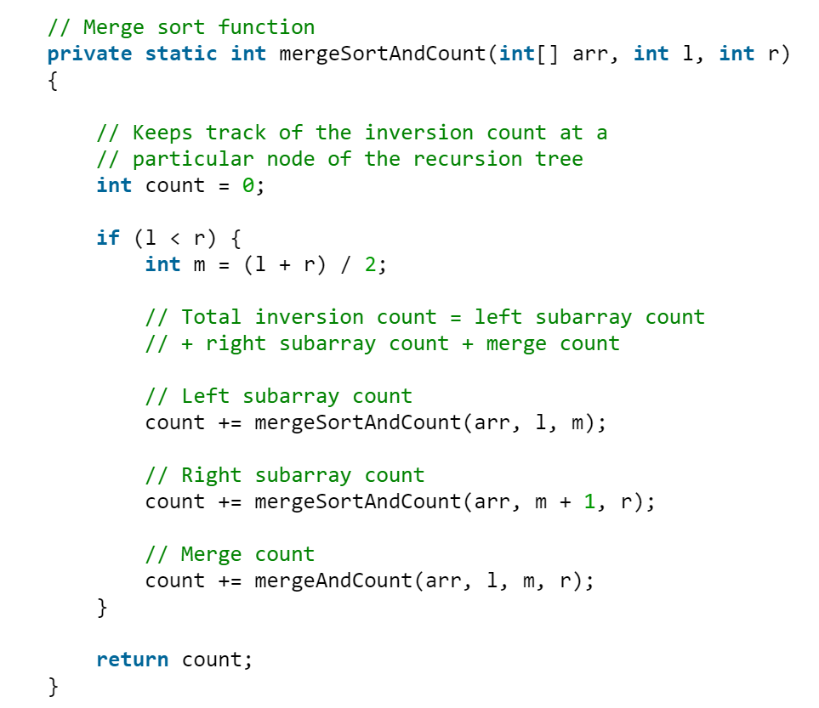
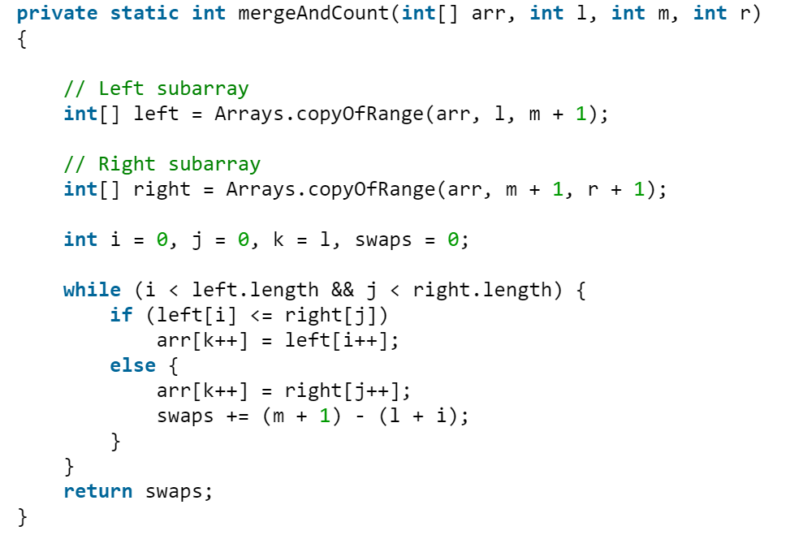
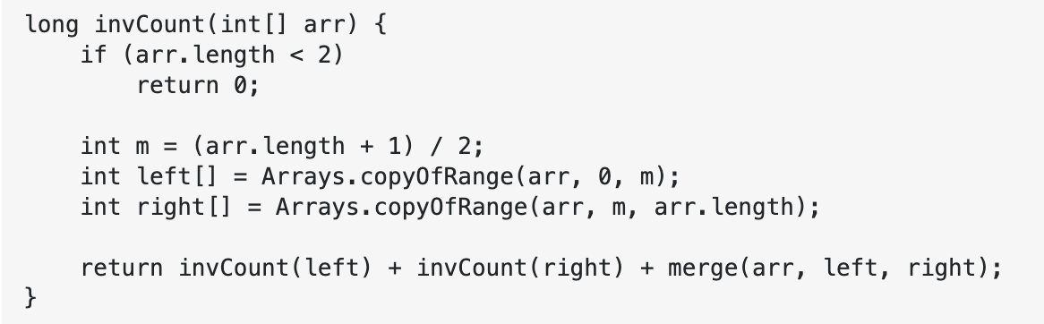
divide
conquer
&
merge

Slide 12
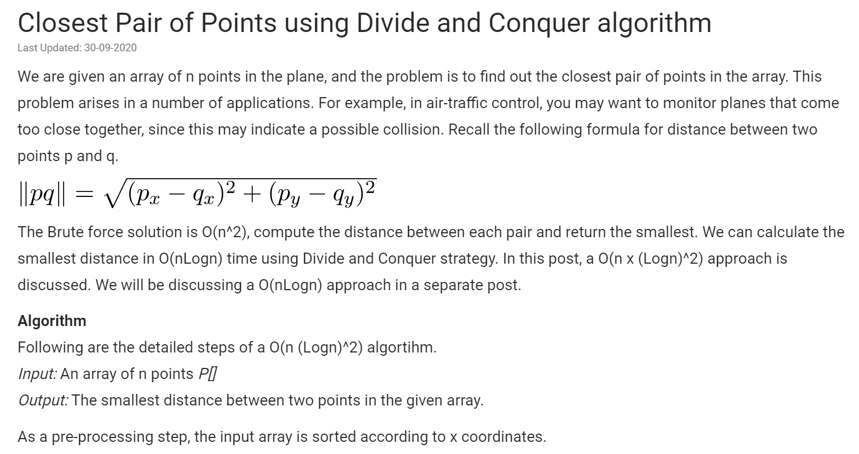
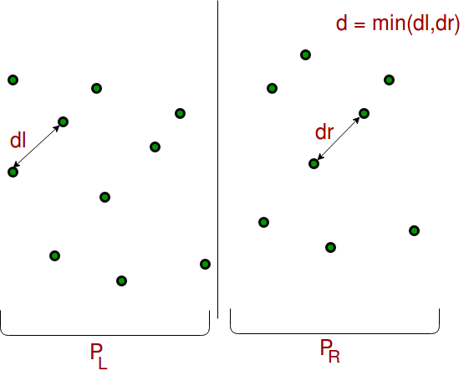
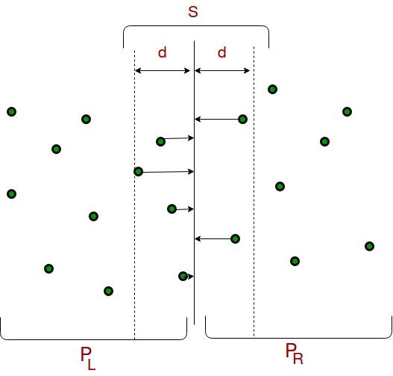

Slide 13
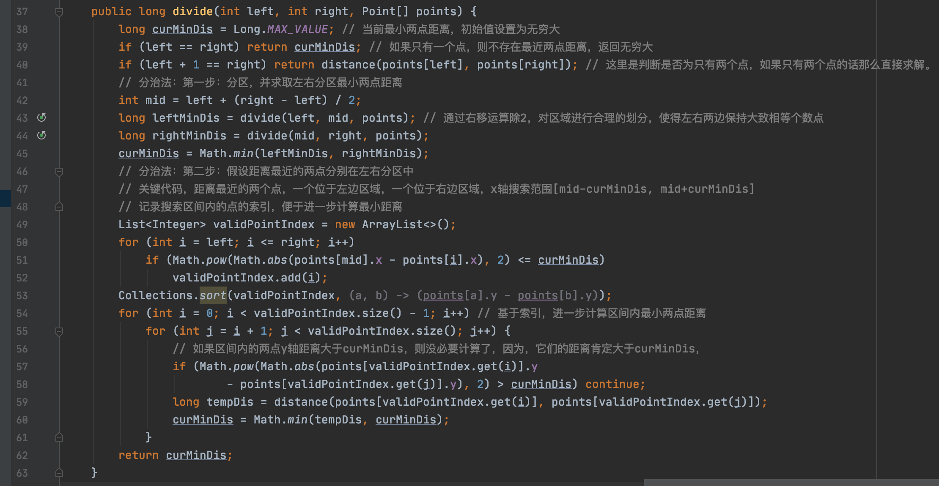
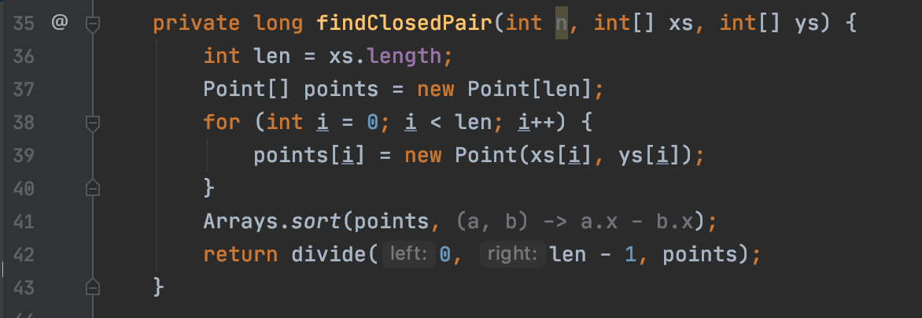
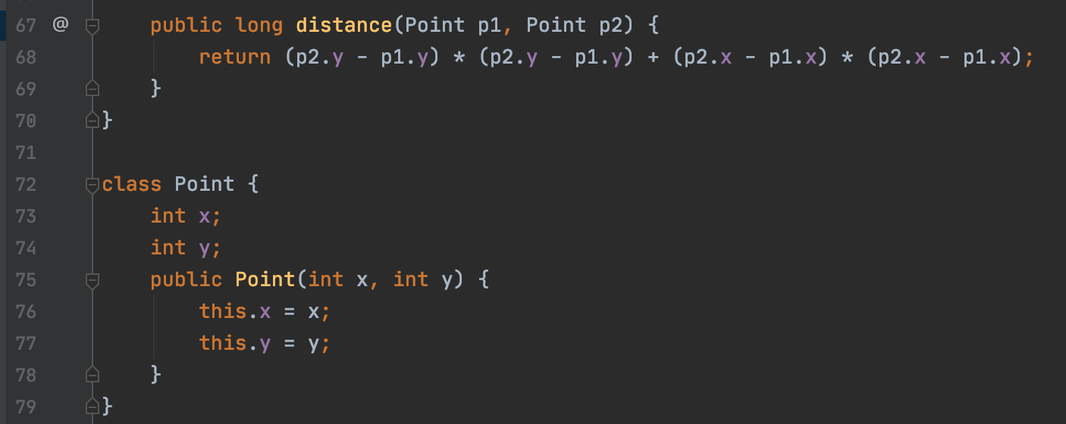
// Pick all points one by one and try the next points till the difference between y coordinates is smaller than d. This is a proven fact that inner loop runs at most 6 times

Slide 14
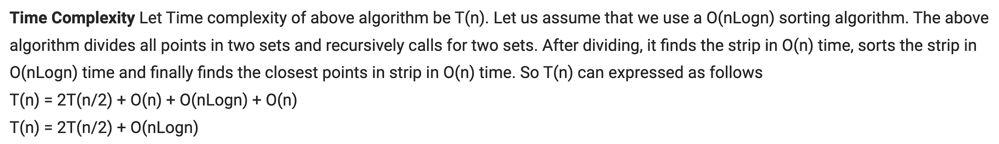


Slide 15
There is a O(nlogn) solution
to avoid the sort by y of points in the stripe area
we can at the beginning to have 2 array, sorted by x and sorted by y.
if you are interested, you can follow the below link, this is good to know, but not required.
https://www.geeksforgeeks.org/closest-pair-of-points-onlogn-implementation/

Slide 16
Summary - divide and conquer
分解原问题为若干子问题，这些子问题是原问题的规模最小的实例
解决这些子问题，递归地求解这些子问题。当子问题的规模足够小，就可以直接求解
合并这些子问题的解成原问题的解
优势在可以很效率的解决一些困难问题，一般分解为2或者4个问题，最后的时间复杂度和logn有关
《算法导论》第 2 章和第 4 章，你需要了解下『Master Theory』，以及如何求解形如 T(n)=aT(n/b)+f(n)的递归式复杂度

